Slide 1
TRANSHUMANISM The Elevation of humans To a “Posthuman” state
Paradoxes Sunday School Class
August 11, 18, 2019
Mark Durham

Slide 2

TRANSHUMANISM, What is it?
Transhumanism is the belief that humanity has the right to shape its own evolution to enhance human physical and intellectual potential through the use of scientific technologies
Has been a popular theme of science fiction books and films such as 2001: A Space Odyssey, Blade Runner, the Terminator series, The Matrix, Limitless, Her, Transcendence, and Stan Lee and Larry Lieber’s IRON MAN
Rooted in Rosicrucianism and derived from the Kabbalah, thus they believe man will be able to create life itself in living machines or artificial intelligence (AI)
Notes:
MOVIES: Limitless: movie about taking a smart pill. Her: movie about man falling in love with a computer. Transcendence: movie where computer reaches technological singularity (transcendence), with counter-technology movement.
Rosicrucianism: (Webster) an adherent of a 17th and 18th century movement professing esoteric and occult wisdom with emphasis on mysticism and spiritual enlightenment; Jewish mysticism, and Christian Gnosticism. 2 : a member of one of several organizations held to be descended from the Rosicrucians such as Free Masons
Kabbalah: : (Webster) a medieval and modern system of Jewish theosophy, mysticism, and magic marked by belief in creation through emanation (from God, in steps) and a cipher method of interpreting Scripture. 2 a : a traditional, esoteric, occult, or secret matter. b : esoteric doctrine or mysterious art. Asserts that man is evolving intellectually and at some point in time will become God
Golem: In Jewish folklore, an animated anthropomorphic being that is magically created entirely from inanimate matter (clay or mud)
Cybernetics Group: a group of remarkable people who met regularly from 1946 to 1953 to explore the possibility of using scientific ideas that had emerged in the war years (cybernetics, information theory, computer theory) as a basis for interdisciplinary alliances. Developed the CIA’s MK-Ultra (mind control of military enemies) with LSD/Truth serum with hopes to copy what shamans of old did with such drugs for enlightenment (as with apple of Tree of Knowledge…)
MK-Ultra: CIA’s “mind-control” program (for supersoldiers) using psychedelic drugs (LSA)
Nootropics: also known as smart drugs and cognitive enhancers, are drugs, supplements, and other substances that improve cognitive function, particularly executive functions, memory, creativity, or motivation, in healthy individuals. Enhances cognitive responses for Parkinson's, Alzheimer's, Huntington’s, ADHD
“Singularity” = (or Technological Singularity) Point in time when artificial intelligence exceeds the mental capabilities of humans.

Slide 3
TRANSHUMANISM, What is it?
Led initially by the Cybernetics Group, a think-tank of geniuses who developed modern computer and worked with CIA’s MK-Ultra project for military mind control
Intellect enhancement coveted, as in movie “Lucy” (a woman who gains psychokinetic abilities when a nootropic drug is absorbed into her bloodstream), or, Iron Man Tony Stark
The Wish is for human minds to merge with an omniscience Internet once “The Singularity” is reached, per Ray Kurzweil of Google
Internet then becomes the “god” of occultism
Interned then becomes the Masonic All-Seeing Eye on back of American dollar bill

Slide 4
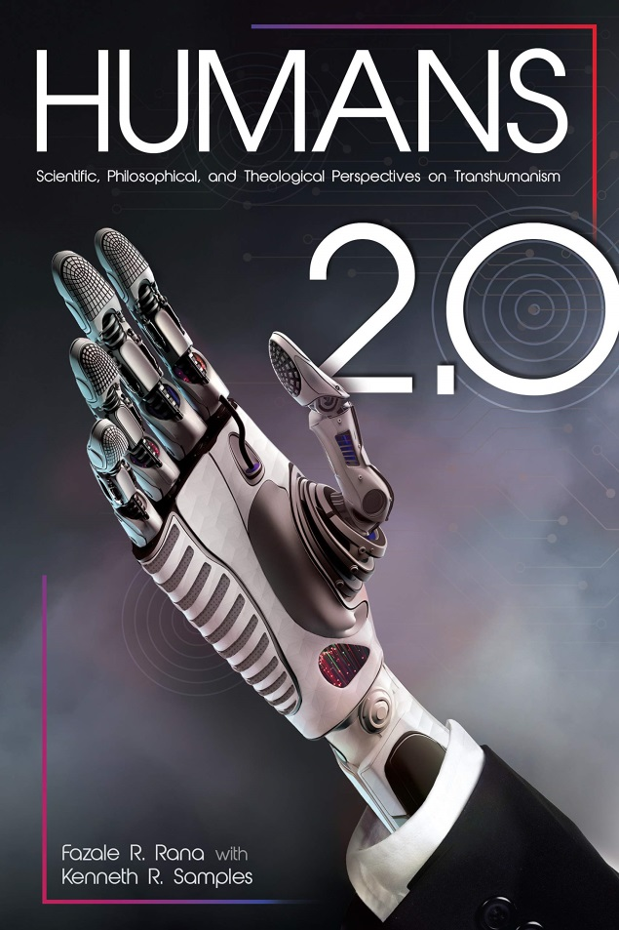
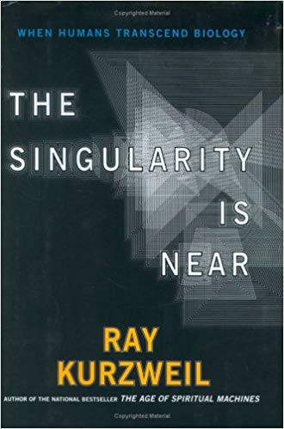
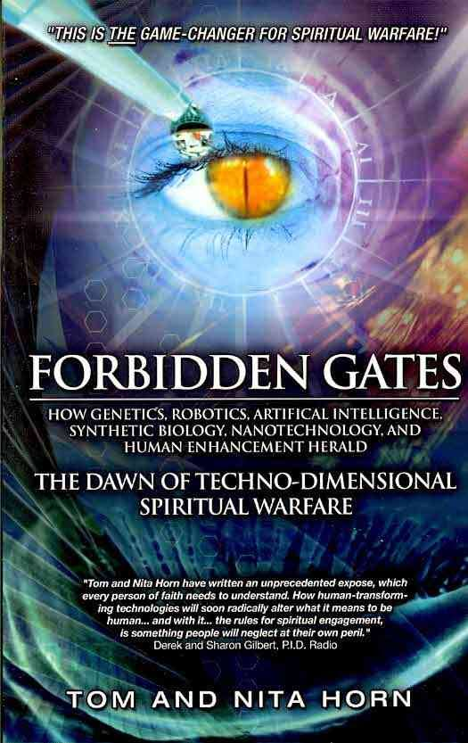
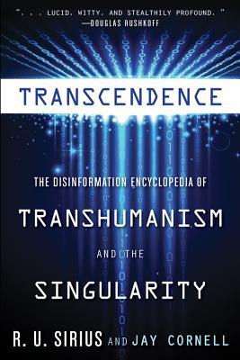
Transhumanism references

Slide 5


Transhumanism references, classic

Slide 6

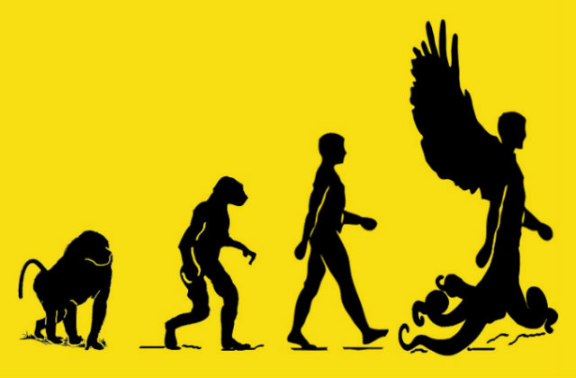


Tour of Transhumanism
Transhumanism Logos
Notes:
Mormon transhumanists believe the coming leaps in science and technology will help them realize the Mormon promise of achieving perfect, immortal bodies and becoming Gods

Slide 7
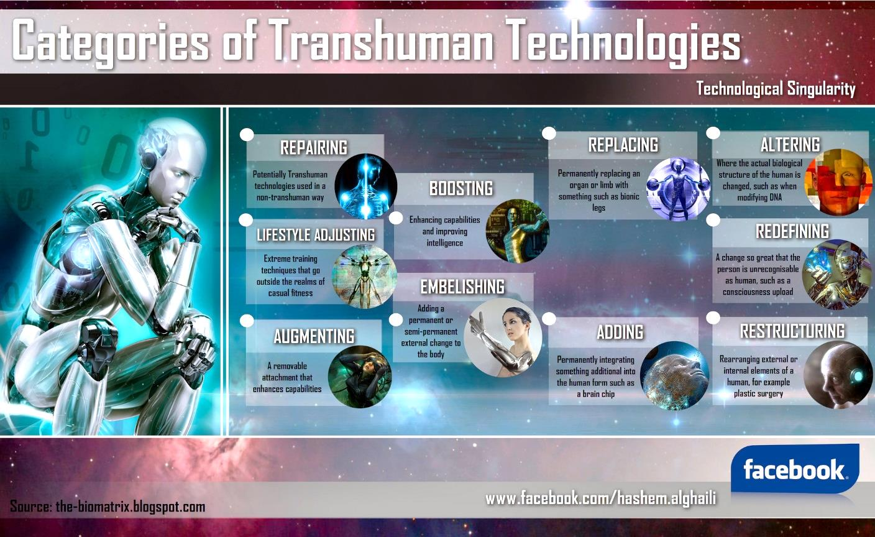
Source: the-biomatrix.blogspot.com

Slide 8
History of transhumanism
Came out of the Enlightenment Movement of the 17th & 18th centuries, which posits that reason is the only legitimate authority.
People find the subject intriguing. Books like Mary Shelly’s Frankenstein, H.G. Wells’ Island of Dr. Moreau, and Robert Louis Stevenson’s Dr. Jekyll and Mr. Hyde. All envisioned transhumans but none of the stories explained how it was done
Led many people into a state of Techno-Faith, a belief that science and technology will solve the world’s problems and end suffering , pain and eventually death
Notes:
Enlightenment a movement initially influenced by the Scientific Revolution, advocated by French scientist/philosopher Rene Descartes

Slide 9
History of transhumanism
Term “Transhumanism” was coined by English biologist and philosopher Julian Huxley in his 1957. He believed that natural evolution could be replaced by human induced evolution
From the 1920’s to present, science fiction genre developed; earliest was Superman Comics, prompted by WWII. In 1960’s to present Iron Man (Marvel) very popular, prompted by Viet Nam War. Many books followed
A proliferation of Transhuman organizations appeared from the late 1980’s to present: Entropy Institute, The World Transhumanist Association, The Transhumanist FAQ, Transhumanist Declaration;, WTA Constitution, Cyborg Democracy, etc.

Slide 10
Transhumanism: A few of the leaders
Nick Bostrom: Oxford U., Institute for Ethics and Emerging Technologies
Aubrey de Gray: Biomedical gerontologist, Runs SENS Foundation & The Methuselah Foundation
Eric Drexler: Engineer at Foresight Institute, Molecular Nanotechnologist
James Hughes: Sociologist/Bioethicist, Director Institute for Ethics and Emerging Technologies (IEET)
Raymond Kurzweil: Scientist/Inventor/Futurist, Director of Engineering at Google
Anders Sandberg: Neuroscience Researcher & Futurist, works in Cognitive Enhancement
Kevin Warwick: Professor of Cybernetics at Reading U, England, work includes AI

Slide 11
The first step: genetic engineering
Single Gene Mutations cause 5000 – 10000 disorders, including sickle cell disease, Huntington’s disease, amyotrophic lateral sclerosis (ALS), cystic fibrosis, muscular dystrophy…
Gene Therapy, a process where specialized techniques are used to deliver healthy gene DNA into patients suffering from genetic mutation(s). Some of those techniques use the following:
Retrovirus (modified virus vector) used to deliver a healthy ADASCID gene into patients’ T cells, early 1990’s
Setbacks followed until 2009 when successes began for such genetic disorders as Leber’s congenital amaurosis (causes blindness), b-thalassemia (causes hemoglobin malfunction), and lipoprotein lipase (causes elevated triglycerides)
Enzymes (nucleases) used to cut out defective DNA strands in nucleus to repair or replace with corrected DNA
Trial use for HIV (AIDS) to disable receptor protein CCR5 on T cells, resulting in some relief of systems
Hopeful but expensive and difficult to use
Notes:
ADA-SCID is Enzyme adenosine deaminase, a genetic mutation resulting in inhibition of cell division, esp. to T and B cells, so the immune system is compromised.
Retrovirus = any of a group of RNA viruses which insert a DNA copy of their genome into the host cell in order to replicate, e.g. HIV. May be used as a viral vector to for scientists to deliver functional genes, or single gene mutation repair/replacement
T Cells = a lymphocyte of a type produced or processed by the thymus gland and actively participating in the immune response

Slide 12
The first step: genetic engineering
CRISPR-Cas9 is a natural occurring genetic modifier found in bacteria that protects them from virus or plasmid attack.
Breakthrough came in 2012 when researchers discovered how bacteria (Streptococcus pyogenes) can become immune to viral attack and how the process could be exploited for gene editing
Gene Editing Therapy: 5,000 genetic disorders of single gene mutations plague humanity which should become repairable with CRISPR-Cas9. Early positive results for the following genetic disorders are promising:
Retinitis Pigmentosa; Hemophilia A; Duchenne’s Muscular Dystrophy; Kidney Function; HIV
Technical Challenges: Worry that viral vector might affect cells outside target cells or elicit a severe immune response in the patient. Such off-target fears make most biomedical scientists hesitate to pursue clinical studies
Transhumanist advocates view CRISPR-Cas9 as the key to opening Pandora’s Transhumanism box and so are very excited
Notes:
CRISPR-Cas9 = CRISPR is “Clustered Regularly Interspaced Short Palindromic Repeats”, Palindromic means can be read as same backwards or forwards. Cas9 is “CRISPR-Associated Proteins 1 thru 9 (enzymes). From bacterium Streptococcus pyogenes.
Currently being worked on: Chronic Granulomatous Disease (defective NOX2 gene, causing loss of resistance to bacterial infection); Retinitis Pigmentosa (eye retina cell loss); Hemophilia A; Duchenne’s Muscular Dystrophy (muscle cell membrane disruption); Kidney function (activated quiescent genes); HPV virus (disabled genes); HIV (deactivate genes in mice); Hunter Syndrome (defective gene dealing with carbohydrate metabolism)

Slide 13
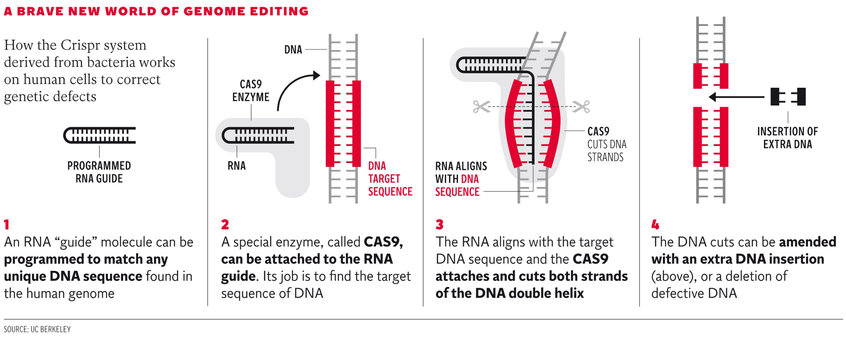
Gene editing: crispr-cAS9 modified for humans
Notes:
Note: This depiction is how researchers use the CRISPR-Cas9 for human gene editing and is less complex than what occurs in bacteria, where a two step process of Immunization and Immunity (bacteria to virus). See p. 47 of Humans 2.0 book. For humans, the “Programmed RNA Guide” replaces the CRISPR…
CRISPRs: "CRISPR" stands for "clustered regularly interspaced short palindromic repeats.“ Cas stands for “CRISPR-Associated” protein. Cas9 is the attached cutting enzyme protein. Also requires a guide RNA (gRNA) to attached at correct DNA locus for human clinical treatment. The 'CRISPR system' was initially found as part of an 'immune system' of sorts in some bacteria, used for cutting apart foreign DNA; it is more complex than the clinical depiction above. Above consists of two parts - the protein itself, called cas9, and a small RNA, called the guide RNA (There are actually a few more pieces, but these are the main two that target DNA). This makes it amazingly easy to target any DNA sequence - just change the business end of the CRISPR guide RNA to your target's reverse complement. The Cas9 protein interacts with the guide RNA and cuts the DNA that the RNA is bound to.

Slide 14
Gene editing with crispr-cas9 Technical Challenges
Unwanted DNA mutations that can accompany the cutting process as from insertions or deletions
“Off-Target Effects”: Guide RNA is only 20 nucleotide base pairs yet can pair with the wrong DNA even when there are 5-6 base pair differences
“Energizer Bunny Problem”: Cas9 enzyme can’t stop editing the genome
Works only for actively dividing cells, so works poorly for nerve and muscle cells
Notes:
Off-Target Effects: CRISPR-Cas9 can not only alter the target site, but possibly hundreds of other DNA sites since human genome is composed of 6.4 billion genetic letters. Efforts are underway to alleviate this problem but we are a long ways away from correcting it
Energizer Bunny Problem: Correction methods being worked on and can go on for years: CORRECT places a special blocking Cas9 once it has done its initial job

Slide 15
Gene editing of human embryos now
Would occur in early-stage embryos to somatic cell DNA
Insures corrected DNA is permanently part of all cells in the person’s body
Could occur right after birth, in womb, or in vitro. Works best if applied as early as possible
Monkey embryos 2014 had 1st successful application of CRISPR-Cas9 to a create diseased model
Mutated human embryos, 2015, corrected defective Beta hemoglobin gene
Normal human embryos, 2015, corrected for Beta hemoglobin and G6PD genes; half were corrected but decision was made to not proceed to clinical use
2017, U.S. and S. Korean used human embryos to correct sudden death in young adults due to heart failure caused by the MYBPC3 gene
Molecular biologist Jun Wu and colleagues at the Salk Institute for Biological Sciences in San Diego, California announced that they had created the first human-pig chimeras embryos in 2017, with hopes to grow organs for transplant into diseased humans
Notes:
Monkey embryos: introduced defective genes so as to study treatments for humans
Mutated human embryos: China, not very efficient; 7 of 81 embryos successful… Of the 7, some had Mosaicism (some tissue corrected, some not)
Normal human embryos: China/US some mosaicism
2017 US & S Korea: 72% successful, and found that going gene editing during fertilization eliminated mosaicism! No Off-target effects. However, the repair DNA did not come from male downer, but oocyte (immature egg cell of ovum), thus efficacy of procedure in doubt
Human-Pig Chimera: None of these embryos were permitted to grow to over four weeks in age and the success rate was small — but in some the human stem cells survived and turned into the precursors for various tissues and organs.

Slide 16
Future of gene editing of human embryos
Scientists want to hybridize monkey and human cells to create models to test mental diseases such as Alzheimer’s Disease, dementia, and Parkinson’s Disease. Ethics come into play, especially for people with religious leaning
“God made the wild animals according to their kinds, the livestock according to their kinds, and all the creatures that move along the ground according to their kinds. And God saw that it was good.” NIV
Scientists make virus-busting antibodies for a range of diseases that cannot be prevented with vaccines. Done by altering the genetic code of human B-cells, coaxing them to make antibodies against HIV, influenza, Epstein Barr Virus (EBV) and Respiratory Syncytial Virus or RSV. CRISPR 2019
Notes:
Human-monkey chimeras: could study diseases, and research for treatments. Ethics come into play, especially for people with religious leaning
Virus busting antibodies: RSV = Respiratory Syncytial Virus, is harmless in healthy people but can be deadly for the very young and old. It causes lung disease that, in the US, puts more than 50,000 kids under five in hospital and kills 14,000 adults over 65 every year

Slide 17

Other Gene editing efforts
Mosquitos: Using CRISPR-Cas9 gene editing, scientists were able to genetically block female reproduction in lab mosquitoes. September 2018
A technique called “gene drive” used to change females into a hermaphroditic state, making them unable to reproduce
Within 7-10 generations all females became “doublesex” and avoided sex with males
Plant Root Growth: To combat ever higher levels of CO2 in the atmosphere, researchers are engineering the Exocyst70A3 gene so that the plant hormone auxin will increase at the root tip, ensuring robust root growth, July 2019
This insures a greater sequestering of this greenhouse gas in plant roots where its stored as cork (suberin)
Muscular Dystrophy in Dogs: CRISPR-Cas9 employed to snip out defective dystrophin gene and replace with a functional one. Dystrophin is a protein essential for normal muscle function. Aug 2018
Dystrophin levels brought to 15% of normal was able to alleviate MS systems
Getty Images/EyeEm
Notes:
There were 216 million malaria cases worldwide in 2016, according to World Health Organization data, which resulted in 445,000 deaths, most of which were children under the age of five. Only 40 related species of the approximately 3,500 mosquito species worldwide can carry malaria, according to Imperial College London. The target is the mosquito species Anopheles gambiae that is responsible for transmitting malaria in sub-Saharan Africa.
Researchers specifically targeted a 'doublesex' gene that determines a mosquito’s gender.
Uses Gene Drive technique, where a desired allele is multiplied in genome so that >50% probability of expression occurs. In 7-10 generations, all female mosquitos become sterile
“It will still be at least 5-10 years before we consider testing any mosquitoes with gene drive in the wild”
Plants: Gene engineering to make plants’ roots grow deeper, thicker, and with more carbon storage underground. Making the work particularly promising is the fact that the Exocyst70A3 gene has very closely related genes in all plants. This gene determines the quantity of root growth hormone auxin. Salk researchers have been investigating ways to engineer plants so that they grow with more robust and deeper roots that are capable of storing increased amounts of carbon underground for longer; thereby reducing CO2 in the atmosphere. This is based on their discovery of a gene which dictates the depth to which plant roots grow in soil. Longer roots mean plants store more carbon in the molecule suberin, which is basically cork
Muscular Dystrophy in Dogs: Duchenne muscular dystrophy, dystrophin gene, which codes for a protein essential for normal muscle function. People born with the disease are often eventually confined to wheelchairs as their muscles continue to weaken, and in the later stages, many rely on ventilators to breathe as their diaphragm muscles stop working. Eventually, they develop heart and respiratory failure.

Slide 18

Potential Human enhancements with crispr-cas9
Enhancement here refers to changing the human genome into something superior from what we now have
To “evolve” our genome in a highly controlled manner
To become genetic engineered posthumans whose changed genome is transmissible to our progeny
Many gene therapy experts have doubts that CRISPR can accomplish real gene therapy, however…
Dogs in China, the muscle inhibiting gene for the protein myostatin was disabled, leading the way for large muscled dogs that could be stronger, faster, at running, hunting, police and military work, and possibly as a model for making “super-soldiers”
Dr Lai: "The goal of the research is to explore an approach to the generation of the new disease dog models for biomedical research for human diseases”
Horses in Argentina: expected birth in late 2019
Credit: Eyevine
Notes:
Dogs: The beagle puppy, one of 27, was genetically engineered by ‘deleting’ a gene called myostatin, giving it double the muscle mass of a normal beagle.
Horses: Researchers in Argentina have successfully manipulated the gene sequences of cloned horses to create a new breed that is physically superior. The “super horse” was engineered to have improved endurance and stamina, and should be able to run faster and jump higher than other racehorses.
Scientists at the Kheiron Biotech laboratory used a powerful gene editing tool known as CRISPR. Expected birth in late 2019.

Slide 19
Potential Human enhancements with crispr-cas9
Designer Babies: Now that we have “designer dogs”, some researchers are seeking genetic enhancement of human embryos for stronger muscles, greater intelligence, beauty, etc.
Most countries deem this to be unethical, but controlling it is difficult
International efforts underway to put ethical constraints on this type of research
“Couples undergoing IVF will be able to pick the 'smartest' embryo within 10 years, controversial US scientist says”: July 2019 Daily Mail
Stephen Hsu of Genomic Prediction told the Guardian his tech will be very precise within 5-10 years
He insists we have an 'ethical responsibility' to screen for low IQ
Ethicists warn this technology and those ideas hark back to eugenics
CRISPR-Cas9 gene editing kits for amateur biologists now being sold from $35 to $5,000
Notes:
IVF = In vitro fertilization

Slide 20
Potential Human enhancements with crispr-cas9
UN: Gene editing for human reproduction is ‘irresponsible’. By JAMEY KEATEN and MARIA CHENG March 19, 2019
An expert committee convened by the World Health Organization is calling for the U.N. health agency to create a global registry of scientists working on gene editing to examine the scientific, ethical, social and legal challenges of such research
Stopped short of calling for a ban

Slide 21
Transhumanism and Brain-computer interfacing
Brain-Computer Interfacing (BCI): This is the “…emerging technology that allows the brain to transmit and receive information from an external device such as a computer or robotic limb.” ( p. 68 Humans 2.0 by Fazale Rana and Kenneth Samples of RTB)
Brain Implants: implanted electrodes to stimulate and alleviate Parkinson’s and Alzheimer’s symptoms
Neuroprosthetics: devices that interface with brain such as Cochlear Implants, & visual aids (pending)
Algorithms: uses mathematical models to convert information from or to brain in order to control a device
Elon Musk’s Neuralink : A startup company trying to directly link brains and computers
“Neuralink has the potential to dramatically reshape both computing and humanity -- if it and like-minded researchers can persuade regulators and society at large that we should be directly wired to machines.”
https://www.cnet.com/news/elon-musk-neuralink-works-monkeys-human-test-brain-computer-interface-in-2020/
Notes:
18 minute Elon Musk video; he finishes at 8 minute mark; go to 14 minutes

Slide 22
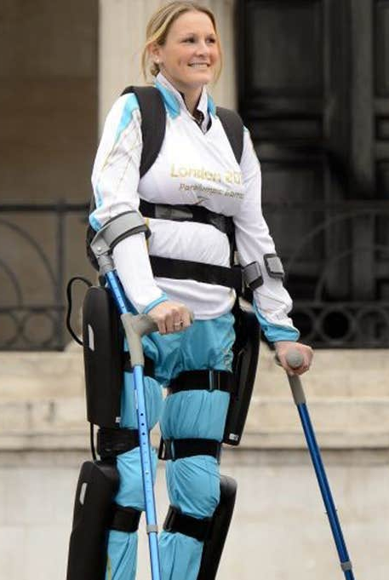
Transhumanism and Bci exoskeleton Control
Mechanical Exoskeletons for para- and quadriplegia, as well as to rehabilitate stroke victims has advanced dramatically
These wearable mobile machines operate through a system of motors, levers, pneumatics and hydraulics
Function as an external skeleton and muscular system
A non-invasive BCI using EEG technology prompted patients to learn to move exoskeleton appendages with thoughts
Claire Lomas paralyzed from the chest down by a horse riding accident has become the first person to take home a robotic exoskeleton that enables her to walk.
Notes:
BCI = Brain Computer Interface
EEG technology in 2015-6, Brazil

Slide 23
Transhuman vision with Brain-computer interfaces (BCI)
The technology for cochlear implants and blindness repair can be adapted to enhance human hearing with extended frequency range, and sight beyond the normal visible spectrum
Exoskeleton Enhancement: Desire to be able to lift 250 pounds as though it is 10 pounds
Power sources with nearly perpetual energy: e.g., pencil sized rocket motor, or tiny nuclear power generators
Electronic Skin with sensory ability beyond our five senses; e.g., magnetism
Brain Stimulation: to affect a person’s sociological outlook; e.g., inhibit discrimination tendencies

Slide 24
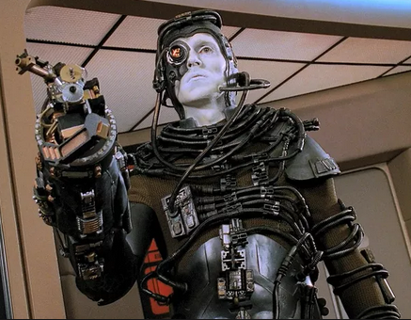
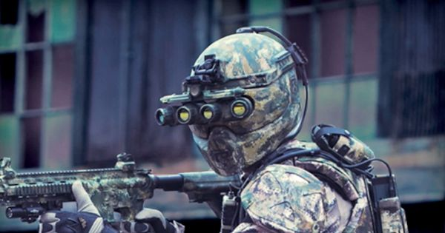
Transhumanism and Bci exoskeleton Control—the future
Liquid Armor from U.S. Army
Borg Drone from Star Trek
Notes:
Super-Soldiers: Unlike the metallic, clunky suit of Iron Man, these military operators need to move with great mobility; therefore, the suits will be made with a “liquid body armor” that transforms into solid within milliseconds when a magnetic field or an electric current is applied through the material.
The Borg are a fictional alien group that appear as recurring antagonists in the Star Trek franchise. The Borg are a vast collection of "drones", or cybernetic organisms, linked in a hive mind called "the Collective" or "the Hive". The Borg co-opt the technology and knowledge of other alien species to the Collective via a process of "assimilation“.

Slide 25
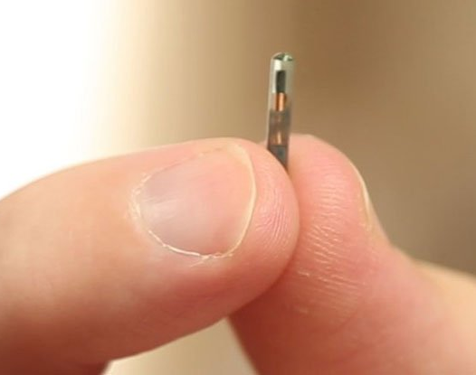
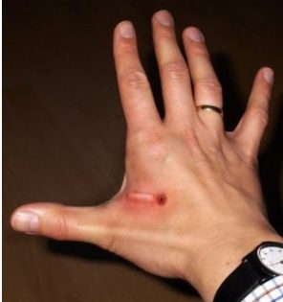
Transhumanism, Microchip implants 1st step toward cyborgs?
Credit: BeforeItsNews
A company in Wisconsin has become the first in the US to roll out microchip implants for all its employees, and says it's expecting over 50 of its staff members to be voluntarily 'chipped' next week. Peer pressure complaints are reported
Rev. 13:16-17 And the second beast required all people small and great, rich and poor, free and slave, to receive a mark on their right hand or on their forehead, so that no one could buy or sell unless he had the mark—the name of the beast or the number of its name.…Berean Study Bible Download
https://video.search.yahoo.com/search/video?fr=jnazafzv&p=microchip+implant+in+hand#id=3&vid=95b452b86e29eca1a6e674dff69e9658&action=view
Notes:
Currently it is optional but some employees have reported peer pressure to “get chipped”. Common in EU
USES: Animals that are lost, pet doors, vaccination proof, wildlife tracking
PEOPLE: Good: medical records, building security/access, missing persons, fugitives, vending machines, public transportation, etc
PEOPLE: Bad: political repression, compromise privacy, (Some States with laws prohibiting mandatory requirement)
The initiative, which is entirely optional for employees at snack stall supplier Three Square Market (32M), will implant radio-frequency identification (RFID) chips in staff members' hands in between their thumb and forefinger

Slide 26
Human acceptance of transhumanism
BCI technology presently is more acceptable to most people than gene editing for enhancement
Prosthetics have been around for centuries: false legs and arms, hearing horns and aids, eyeglasses
Mental diseases such as Parkinson’s and Alzheimer’s diseases are on the increase and so eventually brain implant devices will become an acceptable way to go
Smartphones are now a necessity to most people and so BCI implants will become acceptable, AND, will connect us all with the unlimited information of the Internet—the temptation of unlimited knowledge is a temptation hard to resist…
The younger generation, accustomed to technology in their everyday life, will find it easy to shift towards a Transhuman vision

Slide 27
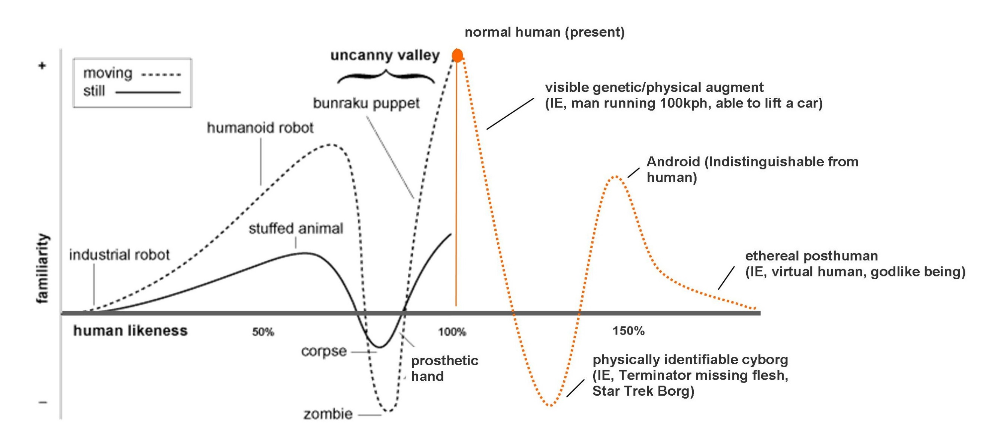
Human acceptance of transhumanism
Uncanny Valley, GFDL, Tracy Atkins
Notes:
Author Tracy Atkins, a Transhuman advocate, graphically shows how humanity will go through positive and negative stages of “familiarity” along the road to Transhumanism. During the negative periods, the newness/uniqueness of the progressive changes will result in “uncanny valley” situations where humans will react against the movement either emotionally or even violently. But, in the end he believes the complete Transhuman change will prevail, and we become “virtual human, godlike beings”… Do you think people of God will follow this predicted path???
Bunraku is Japan's professional puppet theater. Developed primarily in the 17th and 18th centuries, it is one of the four forms of Japanese classical theater, the others being kabuki, noh, and kyogen. The term bunraku comes from Bunraku-za, the name of the only commercial bunraku theater to survive into the modern era

Slide 28
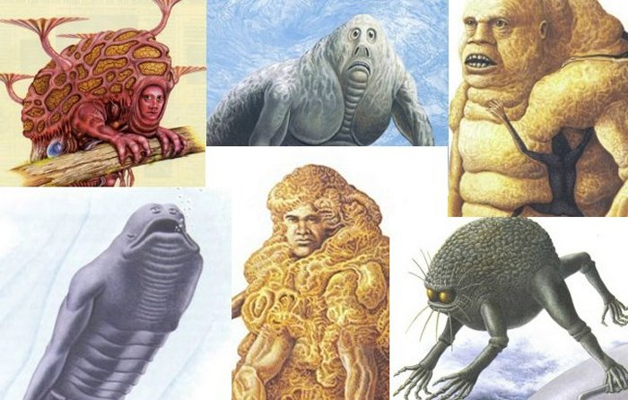
Human enhancement & the future
Speculative transgenic changes to what was once human
These human-devised hybrids, likely through genetic manipulation, are reminiscent of a race of giants in Noah’s and David’s time
Genesis 6:4: “The Nephilim were on the earth in those days, and also after that, when the sons of God came in unto the daughters of men, and they bore children to them; the same were the mighty men that were of old, the men of renown.”
The Book of Enoch describes the Nephilim as resulting from cross breeding of humans with a special class of angels known as Watchers
Genetic engineering and space travel could change our appearances. Image credit: Man after Man – An Anthropology of the Future by Douglas Dixon
Notes:
Transgenic: of, relating to, or denoting an organism that contains genetic material into which DNA from an unrelated organism has been artificially introduced.
Nephilim were giants resulting from hybridizing human with angelic genes. The Book of Enoch describes the Nephilim as resulting from cross breeding of humans with a special class of angels known as Watchers. The latter also taught man acts of war, witchcraft, sorcery, and more sinful deeds.

Slide 29
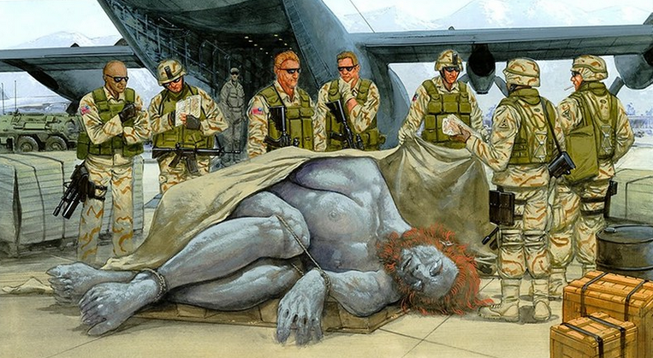
Human enhancement & the future
Credit: Giants, Super Soldiers, and the Days of Noah - Steve Quayle & Tim Alberino
Will our zeal to obtain “super soldiers” tempt us to bring back the Nephilim?

Slide 30
Transhumanism: current technical status
Much progress with mathematical algorithms for BCI
Hardwiring brain with computers hinders mobility
Wireless BCI better but subject to neurosecurity issues: glitches or illegal hacking of data; e.g., ID Theft
Attempts to upload the human mind into a computer system are very problematic due to belief that our thoughts are physical (biochemical) in nature—this could bring on a conclusion that we are either non-spiritual or spiritual beings
Plans to connect all humans mentally with a “brain net” would be convenient but could become a means of government control, or lead us into a dystopian world like the hive-like “Collective” of the Borg
Notes:
Brain Net = BCI connection between all people whereby we could communicate with everyone with thoughts

Slide 31
Increasing human life expectancy
Cloning of diseased organs from embryonic stem cells is largely acceptable for therapeutic purposes of replacing aged organs, but not for reproduction
Yet other researchers see it as a means to obtain cell replacement therapies to slow or end senescence
A drastic longer life expectancy, or even immortality, would change families and societies drastically
Anti-aging technologies are advancing due to medications, biochemical, genetics, nano-machines, organ/tissue transplant, food (caloric) intake, life style changes
Notes:
Aubrey de Gray, biomedical gerontologist, believes we can’t allow ourselves to believe in immortality
Stochastic = randomly determined; having a random probability distribution or pattern that may be analyzed statistically but may not be predicted precisely.
Efficacy = the ability to produce a desired or intended result. Falsify: the act of disproving a proposition, hypothesis, or theory
Oxidative Damage = Free radicals or Reactive Oxygen Species (ROS) produced in mitochondria including Superoxide Anion (O⁻₂), hydrogen peroxide, and hydroxyl free radical. Free radicals at just right concentration, speed up wound healing process and kill pathogens. At too great of concertation can cause Oxidative Stress and harm tissues. Two naturally enzymes or antioxidants (superoxide dismutase and catalase) act to deactivate free radicals, changing them to hydrogen peroxide and then to water

Slide 32
Increasing human life expectancy
Aging is thought due to a random (stochastic) number of mechanisms, a few of which are:
Protein cross-linking (corruption)
DNA mutations and diminishing ability to repair, leading to cancers and tissue malfunction
Oxidative damage: oxygen needed to live but also generates Free Radicals or Reactive Oxygen Species (ROS), which harm cells in bodily tissues, but serve
Mitochondrial Damage to membranes slows down metabolism and tissue repair. Caused by ROS
Gene damage for antioxidant enzymes superoxide dismutase and others makes tissues vulnerable to Free Radical damage

Slide 33
Increasing human life expectancy
No “Grand Unifying Theory of Aging” yet, per gerontologist
Anti-Aging Methods now being studied include the following:
Caloric Restrictions extends life expectancy
Slowing Metabolic Rate
Exercise
Biotechnology: genetic engineering for more superoxide dismutase & catalase. Also, biochemicals such as NMN and NR
Telomerase: This enzyme resets telomere loss (located at tips of chromosomes)
Question: What would life be like if we could live hundreds of years?
Notes:
Although NAD itself is difficult to administer directly to humans, its precursors—nicotinamide riboside (NR) and nicotinamide mononucleotide (NMN)—are promising natural compounds with which to augment NAD levels in the cells and the body. Both NR and NMN have been shown to be beneficial to ameliorate complications in glucose metabolism, cardiovascular and neural functions, and stem cell maintenance, and even promote longevity in some models. For NR, several clinical studies have already been ongoing in the US and Europe.
Telomerase: resets decreasing telomere length on chromosomes, which get progressively shorter with each cellular division. When telomere length is restored, organism lives longer, healthier life

Slide 34
Human enhancement technology: ethical concerns
High Cost: Who will be able to afford it?
Should We Play God? I.e., can we create as He does without usurping His authority?
Somatic Stem Cells or Human Embryo Stem Cells--Which therapies uphold human worth and value!?
Somatic stem cells are obtained from adult non reproductive tissues (skin fibroblasts, umbilical chord, blood) and coaxed to be pluripotent; they are used to treat diseases such as Leukemia, (bone marrow transplant), and pending, heart conditions and diabetes. This is not a means of reproductive therapy
In early developmental stages now; somewhat costly until process is perfected
Notes:
High Costs: Insurances likely won’t pay for it because it is NOT a medical necessity; i.e., its not a disease. So it may turn out that only the wealthy can indulge. Could develop into a posthuman world of “haves and have-nots”. Costs may come down as supply and demand increase
Should We Play God: Since we are made in God’s Image per Genesis 1:27, we are compelled to try to be like Him; “Whenever we create, design, invent, etc., we manifest the image of God.” Humans 2.0, p 129. Example of usurping His authority is the Tower of Babel per Gen. 11:1-8
Human Embryo Cells or Stem Cells Therapies: Believing that the fertilized egg is a human, the latter is the alternative of choice. My personal story is of using a donor’s stem cells to replace my defective bone marrow cells, for Acute Myeloid Leukemia (AML)… (Cancer patients with tumors can usually get by with their own stem cells so there is no fear of rejection). For me, Graft Verses Host Disease (GVHD) could be an issue if my donor’s cells begin to reject my body—After nine months I have had no GVHD, so thank you Lord Jesus!

Slide 35
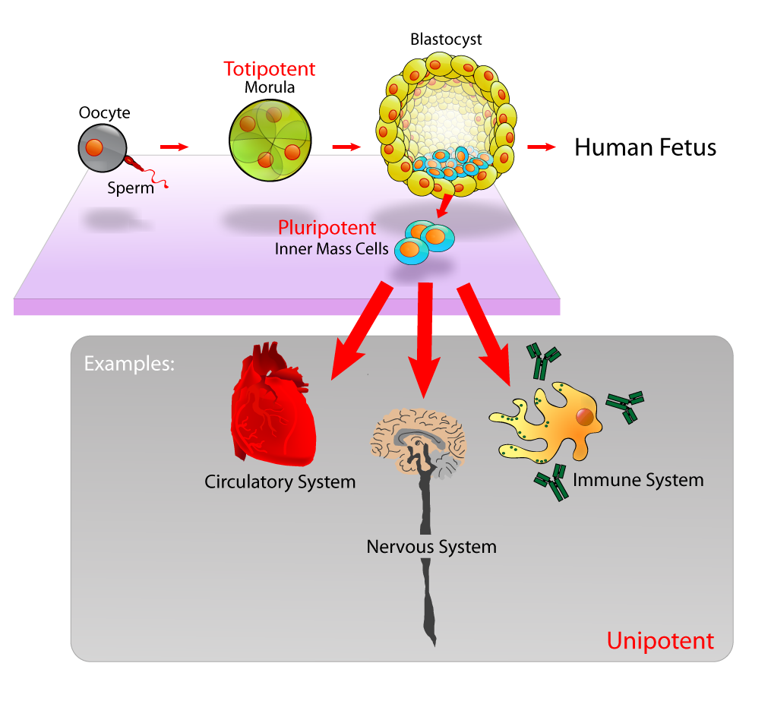
Human enhancement technology: ethical concerns
Human Embryo Stem Cells are obtained from very early embryo development after in vitro fertilization. Embryos are sacrificed and totipotent or pluripotent cells are harvested and used to treat various diseased organs
Note: Human embryos can also be kept intact after in vitro fertilization; they are then treated for genetic defects, with desired embryos kept for reproduction; remaining embryos are destroyed, discarded or used for scientific research
Credit: Wikipedia
Notes:
Totipotent = cells that can be used for repair of any organ and tissues, from Morula (16 cells)
Pluripotent = cells that can be used for repair of most organs and tissues (from inner mast cells of blastocyst)
Unipotent = cells that can be use for repair of certain organs and tissues
In Vitro = in glass
In Vivo = in (or on) organism
In Situ = in place (geology, archaeology…)

Slide 36
Human enhancement technology: ethical concerns of the embryonic cellular approach
Eugenics: Selection of the most desired embryo, at the expense of many others that are terminated, raises ethical questions. Is it just a subtle form of high tech Eugenics leading to “designer babies”, or eventually, Posthuman babies?
Technology Addicts: Could we become so dependent on embryonic cell reproduction that we lose our Human Identity? I.e., we might lose the joy of being part of nature as biological creatures
Salvation Paradox: Per philosopher Patrick Hopkins, rather that saving our species from extinction as transhumanists proclaim, genetically modified humans would replace our species
Disregard of God’s Word: Psalm 139:13-14 (NIV) tells us “For you created my inmost being; you knit me together in my mother’s womb. I praise you because I am fearfully and wonderfully made…” Because our bodies and spirits are closely coupled, most Christians resist the thought of our progeny becoming genetically modified posthumans
Technology Nightmare: Our new “creations” may become our greatest existential risk as new threats that we have never encountered; e.g., super-soldiers…
Notes:
Eugenics: This is the selection of those who can breed based on their superior genetic qualities, and prevention of others from breeding based on their inferior genetic qualities. Popular in U.S. at turn of 19th Century, but corrupted by Nazi is 1930’s—think of Holocaust…
Technology Addicts: Although humans thrive and desire technology, which separates us from all other creatures because it is one attribute of our being made in God’s Image.

Slide 37
Human enhancement technology: ethical concerns of the embryonic cellular approach
End of Senescence (Aging): Embryos genetically engineered for immortality would usher in a new posthuman era. Foreseeable problems include overpopulation and drastic birth rate control; unfairness with employment., natality (who gets to have children); competition and distrust with offspring leading to selfishness and narcissism; distrust of offspring towards parents
Loss of Freedom & Autonomy: Genetic screening would remove reproductive freedom with mandatory in vitro fertilization, editing and selection for implantation
Loss of Justice: Very costly genetic engineering procedures will be unjustly available only to the rich. Their offspring will be fitted with superior strength, health, intelligence, etc.
Harvesting of Embryonic Cells & Tissues: Worn out tissues and organs replacement for adults is feasible by growing one’s own embryos to a more mature stage, then sacrificing them for body parts. This would be limited to those who could afford it

Slide 38
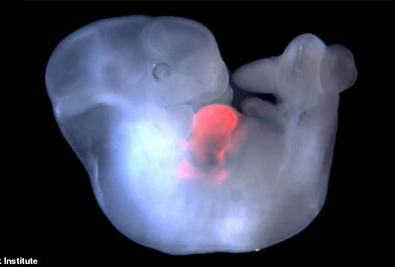
Human enhancement technology: ethical concerns of the embryonic cellular approach
Scientist grows first human-monkey hybrid for possible organ production for people
Human-monkey hybrid, 14 day old embryo
Notes:
1 Aug. 2019. A Spanish scientist has grown the world's first-ever human-monkey hybrid in a lab in China which was viable and could have been born — but the process was aborted. They injected the embryo with human stem cells — which are capable of creating any type of tissue — into the embryo.
Although the breakthrough experiment is an important step towards using animals for human organ transplants, it had to take place in Chine to avoid 'legal issues'. The embryo was destroyed at 14 days of gestation — a point dubbed the 'red line' — meaning that the embryo could not develop a central nervous system. Juan Carlos Izpisúa Belmonte was also responsible for creating the first human pig hybrid in 2017.
Note: fetal heartbeat at 5.5-6 weeks into gestation. In 5-6 weeks of gestation, brain starts sending electrical signals…

Slide 39
Human enhancement technology: ethics of secular Humanism
Egoism: Each individual acts in one’s own self-interest
But how will conflicts be settled between the enhanced and non-enhanced?
Utilitarianism: Looks for the greatest good for the greatest number
But how can minorities have rights and dignity if the majority is always favored?
Relativism: Standards are subjective and changeable—there are no absolute moral values that are true for all peoples or societies
But what will prevent civil chaos from pervading our world?
Pragmatism: Truth is found in results that have positive human consequences
But what of God’s Word; e.g., sanctity of life—would harvesting or destroying embryos be counter to His word?
From a Christian viewpoint, the Secular Humanism bio-ethics does not protect the rights and dignity of human beings
Most Ethical Proposals today for scientific research are Secular in nature; for this reason a Christian proposal is needed
Notes:
Egoism: could apply to nations too, and thus little control by larger group or other nations; it translates into “I-ism”, as with Friedrich Nietzsche, Ayn Rand, Thomas Hobbes
Utilitarianism:
Relativism:
Pragmatism: Doing what works best—that which is practical

Slide 40
The image of god—humans are exceptional
Advanced Cognitive Capabilities: reflects God’s image
Spiritually we have a Resemblance, Relational, and Representative kinship with God
Human Exceptionalism: Four Qualities
Symbolism: includes writing, language, time, advanced art, music, literature, science, inventing
Open-Ended Generative Capacity: ability to combine and recombine mental elements like objects, people, actions into novel scenarios, allowing us to reflect and construct complex plans
Theory of Mind: We can think of and anticipate what others are thinking and feeling
Capacity To Form Complex Social Networks: to classify and organize people into hierarchical groupings
Animal Behavior differs in Kind, not Degree from Humans’ (per Social-Anthropologists):
Their communications are not open-ended as is human language
Memory differs from human’s mental time-travel thinking
Problem solving not the same as human abstract reasoning
Animal empathy not morality based
Social awareness differs from cumulative culture of humans
Notes:
Differ by Kind and not Degree (counter to Charles Darwin’s Descent of Man, and Selection in Relation to Sex)
Spiritually we have a Resemblance, Relational, and Representative kinship with God: Note: historically spiritual Resemblance was primary but now Relational and Representative are popular. We have innate moral compass and sense of justice; We intuitively know there exist a God and we desire to worship and pray to Him; We relate to God, other people, and his creation; We engage in symbolic thought (language, writing, time, advanced art, music, literature, science, inventing).
Open-Ended Generative Capacity : Scientists have found that human subjects’ brain wave patterns become synchronized when two people are conversing on mutual subjects (sports, movies, music, travel, etc.)

Slide 41
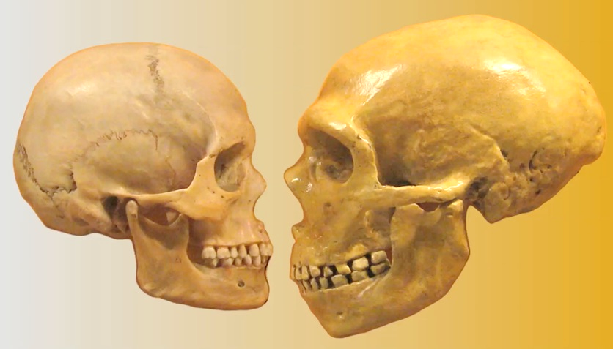
The image of god—humans are exceptional
Neanderthals: This most advanced hominin (along with Homo denisova) has many people hopeful this species is our immediate evolutionary ancestor and behaved as we do
Some Paleoanthropologists Argue Neanderthals’ Behavior Was Like Humans’ And Believe They:
1) Buried their dead; 2) Made specialized tools; 3) Used ochre; 4) Made jewelry; 5) Created art; 6) Could speak in languages
Scientific Scrutiny Gives Little Support for this:
Claims of Neanderthal “exceptionalism” suggest over-interpreted
archaeological records
Childhood Growth Much Faster in Neanderthal than in Human
Based on skull structure and tooth microanatomy of fossilized adolescence
Genome of Neanderthal Different from Humans
Genes differing from human genes effect brain development
Brain Size Similar to Human but is Shaped Differently
Especially important is the Parietal Lobe which deals with language, math,
sense of self, and religious experiences
A Most Powerful Argument for Human Exceptionalism is
Our Technology Abilities for Effecting Transhumanism--This Ability
Displays our Image of God!
Dr Mike Baxter, licensed under Creative Commons 2.0
Notes:
Brain Size/Shape: Neanderthal have an underdeveloped parietal lobe (top center of brain), which is important for language, math, sense of self, and religious experiences. Also, the part of their brain dealing with social networking is smaller. Consequently their cognitive capacity was inferior to humans
Childhood Growth: Humans have a protracted period of childhood

Slide 42
Human biotechnology: Christian ethics
Moral Standards & Ethical Values come from the God of the Bible, He:
has a perfect character and unchanging moral value
is an infinite, eternal and morally perfect being
created and sustains the universe
created life
created human beings in His express image;; i.e., The “Image Of God”; per Psalm 8:5. we are Creation’s Crown
created humans to serve as His surrogates and stewards of His Creation and fellow peoples
provided redemption to repentant sinners through the life, death and resurrection of His Son Jesus Christ
He Gave us Moral Absolutes such as The Ten Commandments:
Thou Shall Not Commit Murder (No. 6)—This imperative is further emphasized in Genesis 9:6, “ Whoever sheds the blood of man shall his blood be shed; for in the image of God has God made man.” Applicable to embryos?
We are to respect others, love our neighbor, help the downtrodden (including those who suffer, and prisoners), uphold justice, subdue and care for Creation, etc.
Notes:
Created Human Beings: Gen. 1:26-27, 2:7 says humans have a dual type of creation from God: Asa, meaning creation of our physical body from existing materials (dust of earth, standardized body plan), and Bara, meaning creation of our spirit that resulted from God’s breath.
Murder: “In killing a human being, a murderer demonstrates his contempt for God as well as for his fellow man.” (NIV footnotes for Gen 9:6)

Slide 43
Human biotechnology: Christian ethics
Humans bear the Image of God: we thus have a creative spirit which provides us with motivation for the pursuit of scientific knowledge as well as new technologies—we need to:
Carry out scientific discovery to help us alleviate suffering and to help us flourish
Strive for technological development
Manage and conserve earth’s resources
Protect our environment
Notes:
5,000 genetic disorders repair could alleviate untold pain and suffering

Slide 44
Worldviews: Christian vs. Transhumanism
CHRISTIAN THEISM WORLDVIEW
Transhuman naturalism worldview
GOD: Transcendent Creator & Sustainer of all things
WORLD: Universe created ex nihilo but depends on Him to exist
KNOWLEDGE: God’s Special & General Revelations
ETHICS: Absolutes, unchangeable & from God
HUMAN BEINGS: Created in God’s Image, though Fallen
HISTORY: Ordained by God and unfolds According to His Will
GOD: Doesn’t Exist (Atheism)
WORLD: Space/Time/Matter is all that Exist
KNOWLEDGE: Science is only Reliable source
ETHICS: From Evolution for Survival & thru Science
HUMAN BEINGS: Evolved from lower Primates but capable of changing to Posthuman
HISTORY: Occurs via Natural Processes & Social Influences
Credit: HUMANS 2.0, F. Rana & K.R. Samples, pp 201, 202

Slide 45
Human biotechnology Ethics
As an Ethical Framework: we need to separate Therapeutic Applications from Human Enhancement Applications
Therapeutic Applications:
Somatic Cell Gene Editing can be used for adults, children or developing fetus. Specific cells/tissues would be treated. This Process is in the early stages of development but holds much hope and avoids killing embryos. Presently there are costs and availability concerns
Embryo Gene Editing to repair many of the 5,000 human genetic defects is further along and less costly but requires creating many embryos, perhaps hundreds/treatment, fertilized in vitro. After processing, the favored embryo is selected and implanted in a woman’s womb, but fate of remaining embryos is dubious
From a Christian Worldview the destruction of an embryo after gene editing is unjustifiable. Psalm 139:13-16 (NIV) tell us “For you created my inmost being; you knit me together in my mother’s womb. I praise you because I am fearfully and wonderfully made; your works are wonderful, I know that full well. My frame was not hidden from you when I was made in the secret place, when I was woven together in the depths of the earth. Your eyes saw my unformed body; all the days ordained for me were written in your book before one of them came to be. “ Thus life begins at conception. Human embryo editing should be abandoned and prohibited

Slide 46
Human biotechnology Ethics for Human enhancement
Enhancement may be good for society in a few cases such as increasing strength or visual acuity
The enhancement must be contained in person(s) receiving treatment in case of mistakes
It must not become transmittable to offspring
Somatic Cells Enhancement:
Enhancement must not be limited to wealthy
It must not result in a “cast” system of those with enhancement vs. those without
It is the best candidate for a Christian-based model of Human Enhancement
Human Embryo Enhancement:
Morally Offensive: involves destruction of many embryos, thus devaluing human life
Exploits women for their eggs
Devalues people with genetic defects
Could result in a loss of reproductive freedom
Could corrupt the human genome by passing changes into our gene pool that are transferrable to future generations
We could lose our identity as human beings, possibly moving into the realm of the Nephilim
If the process went awry it might spell disaster and extinction of the human race

Slide 47
The transhumanist gospel leaves much to be desired
“The Myth of Progress”: Per Michael Burdett, this is a techno-scientific concept that society is continually advancing in all ways
Instead we must realize that such advances can leave serious side effects such as costs, availability, risks of biological runaway mistakes, global terrorism,…
Serves as a Materialistic Eschatology: Offers some hope (over atheistic nothingness)
Techno-Faith: Many in increasingly secular world will embrace a gospel of rationalism, technology and science
“Salvation Paradox”: This is the irony of transhumanism--if a posthuman future is achieved, who we “save” won’t be us…
Notes:
Myth of Progress: belief that humanity/history/science has advanced and is continuing to advance and inevitably will advance in the future; there is an imperfect present but a fulfilled and perfect future
Eschatology: the part of theology concerned with death, judgment, and the final destiny of the soul and of humankind

Slide 48
Witnessing to transhumanists
Engaging: Christians keep it positive. 1 Peter 3:15 (NIV) tells us “But in your hearts revere Christ as Lord. Always be prepared to give an answer to everyone who asks you to give the reason for the hope that you have. But do this with gentleness and respect,”
Find Common Ground: Ethical concerns such as gene editing, brain-computer technology, and anti-aging therapies can greatly help humanity, as can some human enhancement technology
Demonstrate Christian Viability: Tell how the Christian Worldview has important things to offer
An ethical system built around the view that humans are made in God’s Image
Discoveries that highlight humanity’s exceptional nature in accord with the Image of God
Explain how biomedical changes can help humans flourish,
Prevention of exploitation of people
Hope of salvation as defined in the Gospels
Redemption of our spirits AND bodies
Theologians can encourage life-enhancing technology, while keeping a critical eye on the sinful nature of humanity and the transhumanist movement

Slide 49
Christianity & transhumanism
Christianity is the Truest Form of Transhumanism!
1 Corinthians 15:35-44 (NIV) tells us: “³⁵ But someone will ask, “How are the dead raised? With what kind of body will they come?” ³⁶ How foolish! What you sow does not come to life unless it dies. ³⁷ When you sow, you do not plant the body that will be, but just a seed, perhaps of wheat or of something else. ³⁸ But God gives it a body as he has determined, and to each kind of seed he gives its own body. ³⁹ Not all flesh is the same: People have one kind of flesh, animals have another, birds another and fish another. ⁴⁰ There are also heavenly bodies and there are earthly bodies; but the splendor of the heavenly bodies is one kind, and the splendor of the earthly bodies is another. ⁴¹ The sun has one kind of splendor, the moon another and the stars another; and star differs from star in splendor.
⁴² So will it be with the resurrection of the dead. The body that is sown is perishable, it is raised imperishable; ⁴³ it is sown in dishonor, it is raised in glory; it is sown in weakness, it is raised in power; ⁴⁴ it is sown a natural body, it is raised a spiritual body.
If there is a natural body, there is also a spiritual body. “

